Slide 1

Current Status Presentation: Mid-Term Status
By
Hricha Adhikari, Mounika Jakkampudi, Qiao Ma, Bowen Sun, Bingzheng Yan, Sunil Raj Thota

Slide 2









Studer Innotec’s
Datasets
Data Preprocessing
Data Exploration
Data Modelling
BigML
Data Analysis
Prediction
Decision-making

Slide 3

Executive Summary
One of the main goals is to optimize solar power usage and minimize the costs incurred from using genset generators.
We would like to understand the energy consumed by genset by year, month, day and provide insights.
Explore solar power consumption and analyse how it makes a difference

Slide 4
Business Questions
Total Power (kW) and Energy (kWh) Delivered to Installation
1
Total Power (kW) and Energy (kWh) Consumed
2
Power (kW) and Energy (kWh) from Solar Panels
3
Power (kW) and Energy (kWh) from Genset
4

Slide 5

Scope
Data transformation/cleaning using Excel and Python to merge the log files by year.
Once the data is processed and cleaned, use tools like Tableau and Bigml.
Build an interactive dashboard to provide power consumption details by year, month and day.
Make effective findings and recommendations to help answer the business questions.

Slide 6
Data cleaning and Preparation
The first step was to merge the data using Python and Excel scripts to merge the files by year.
The header was assigned manually to maintain consistency and avoid confusion.
Since there is a limitation of 1 million rows in excel, the data was stored in multiple excel files.
All irrelevant data was ignored to make analysis easier.

Slide 7
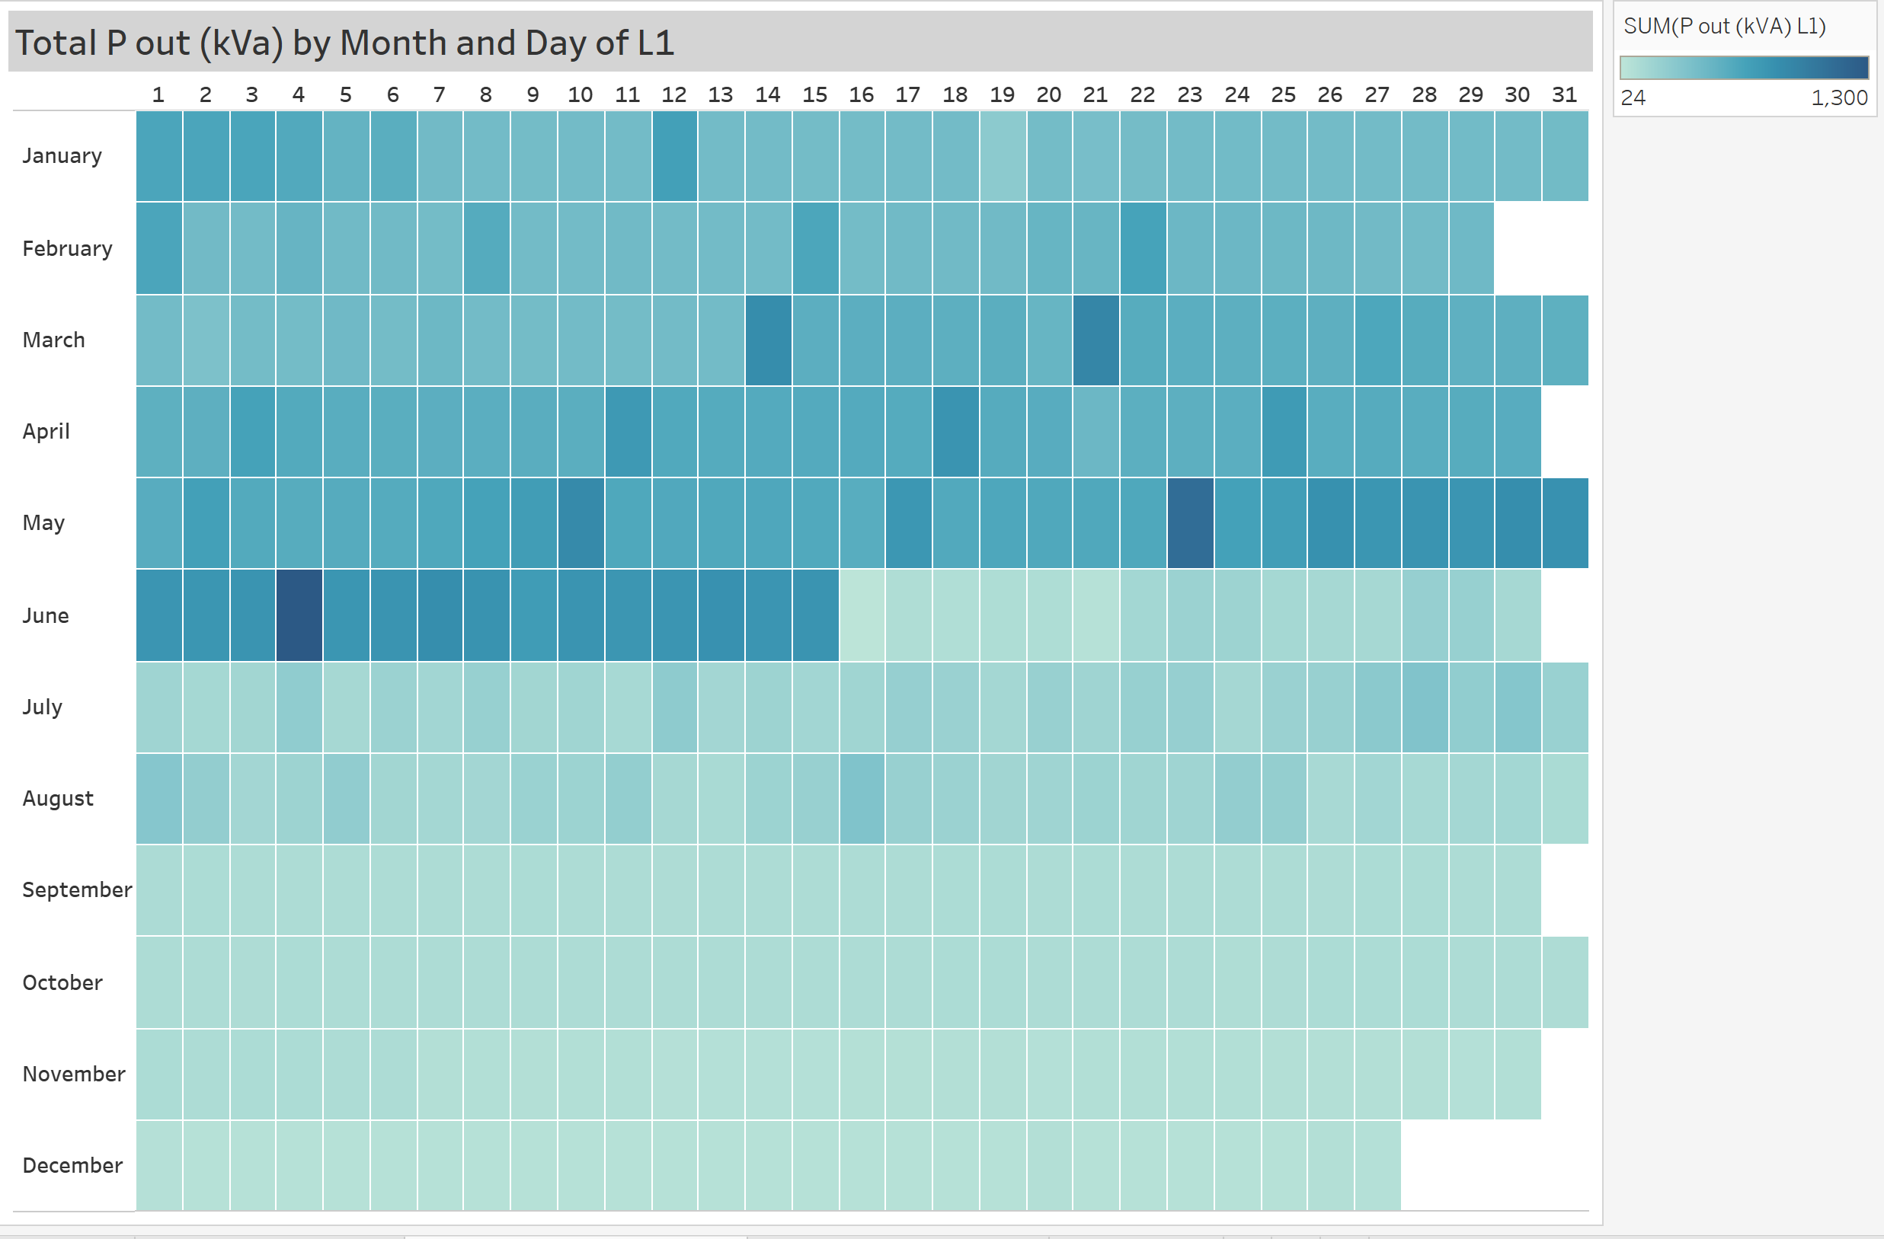
EDA: Total Power delivered for consumption (2020)

Slide 8
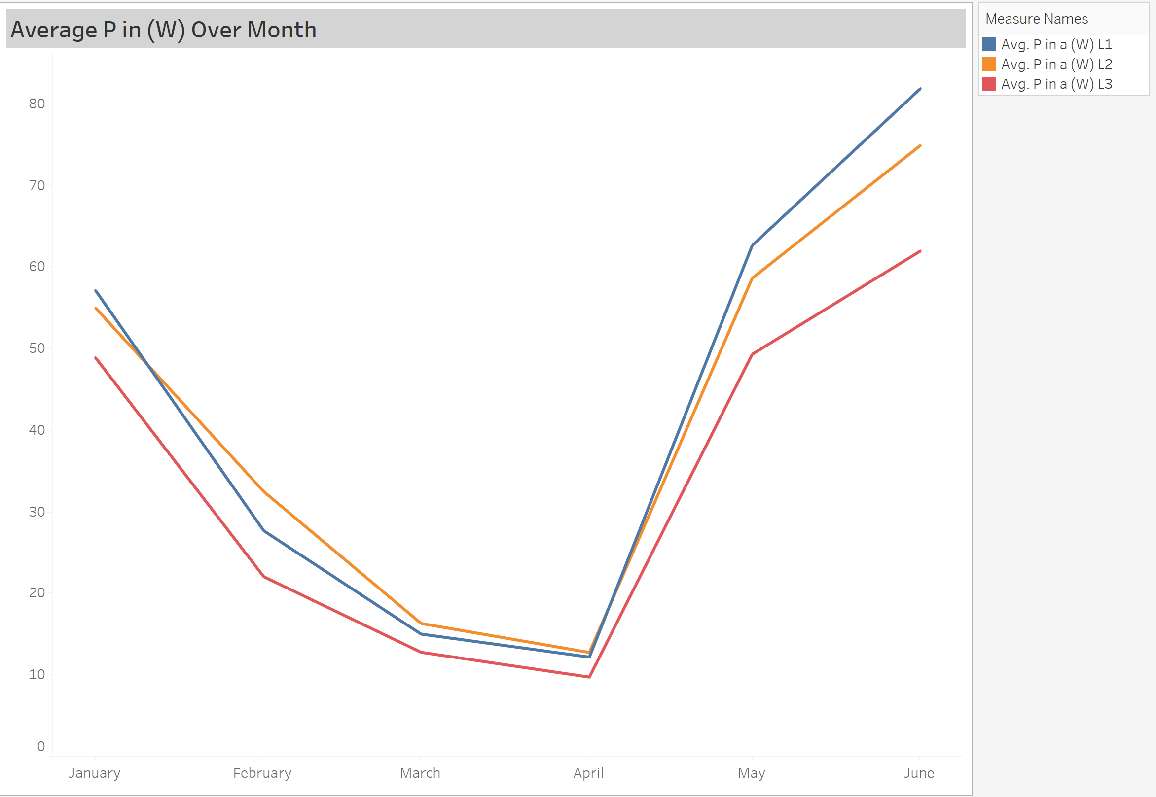
Average Power in (W) Over Month

Slide 9
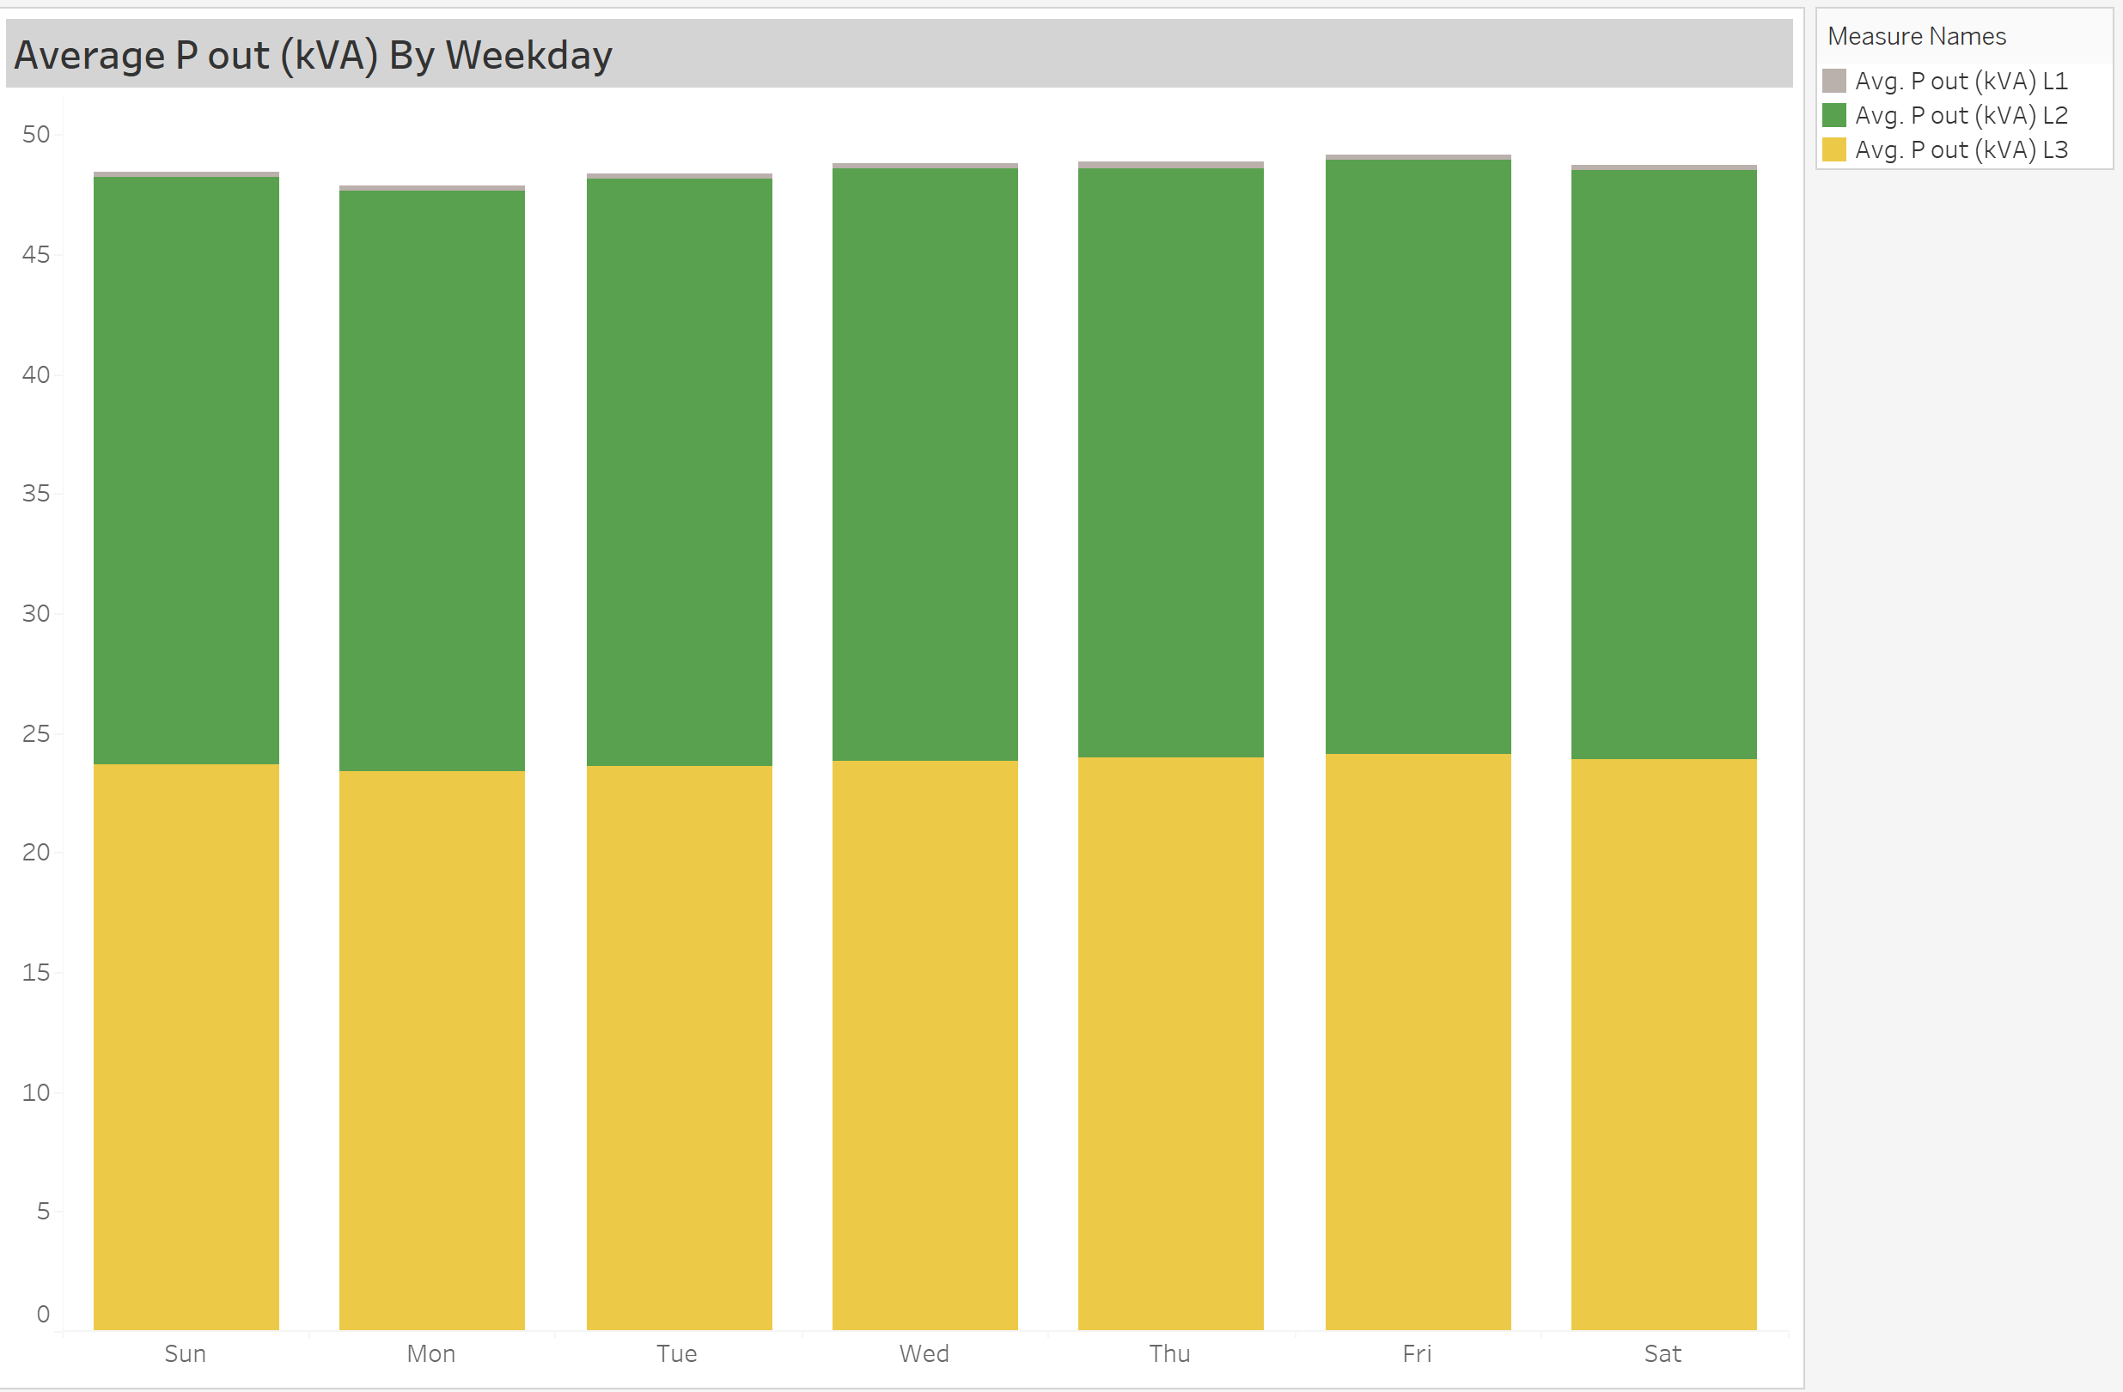
Average P out (kVA) By Weekday

Slide 10
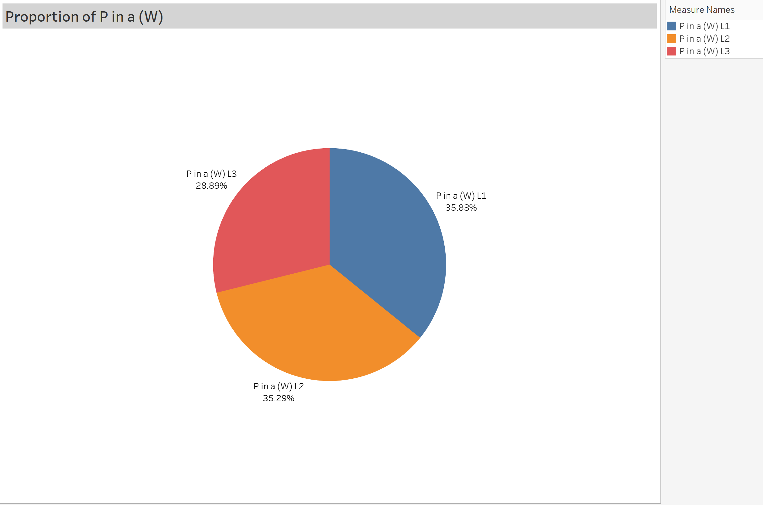
Portion of P in (W)

Slide 11
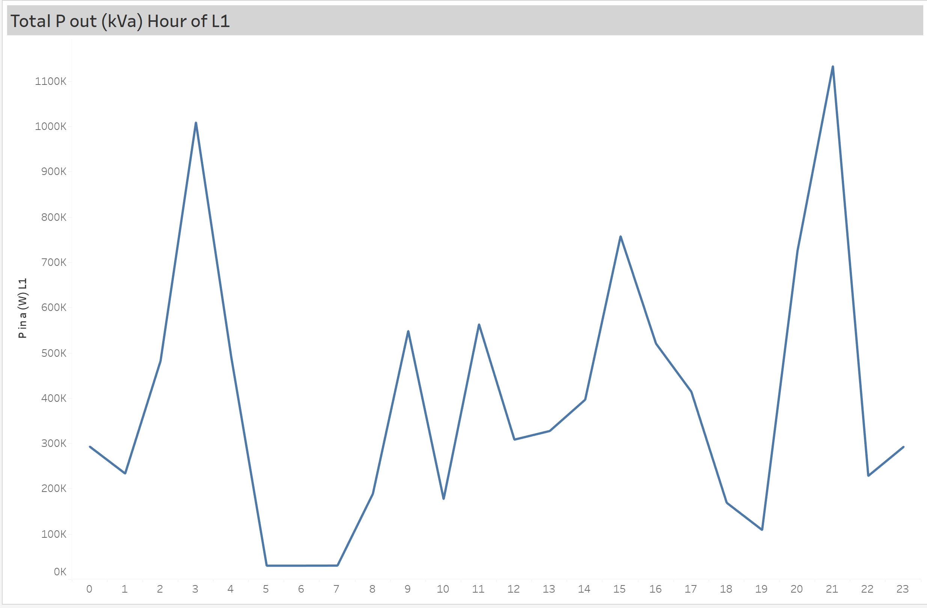
Total P out (kVA) Hour of L1

Slide 12
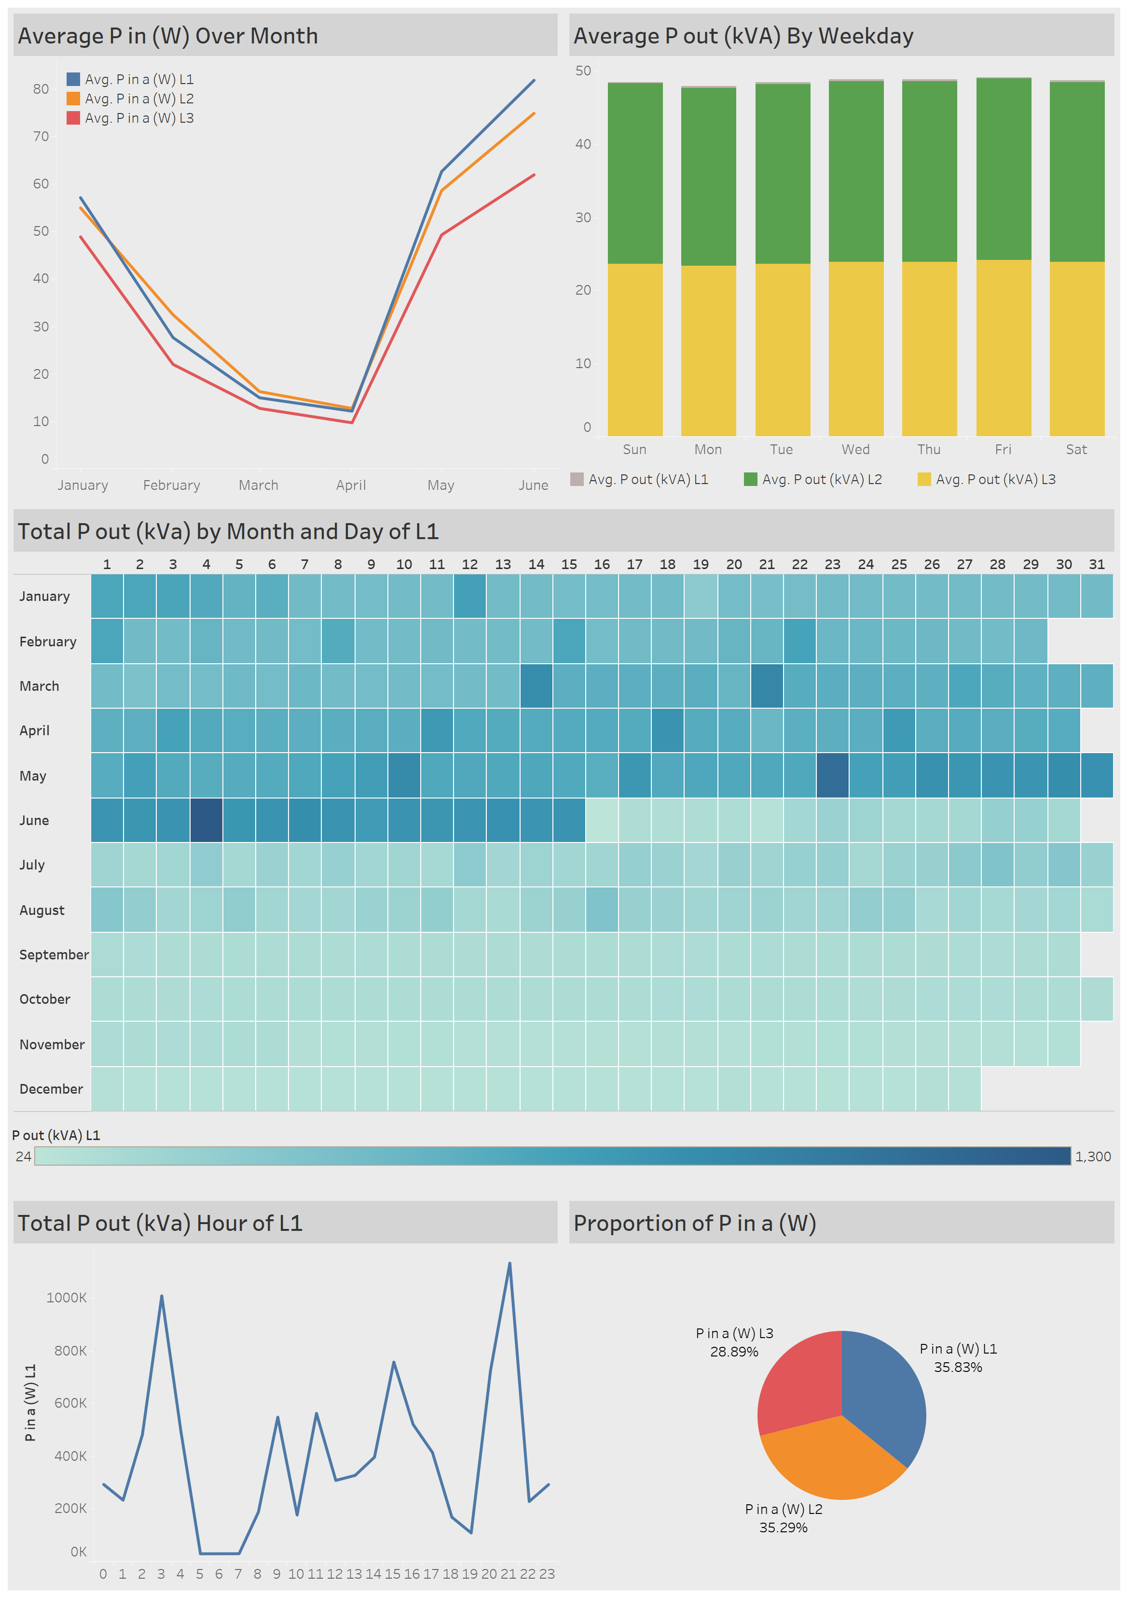
Dashboard

Slide 13

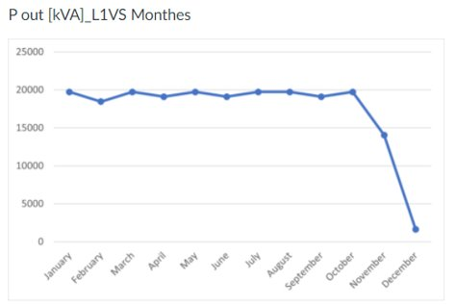
EDA: Average Power out per month

Slide 14
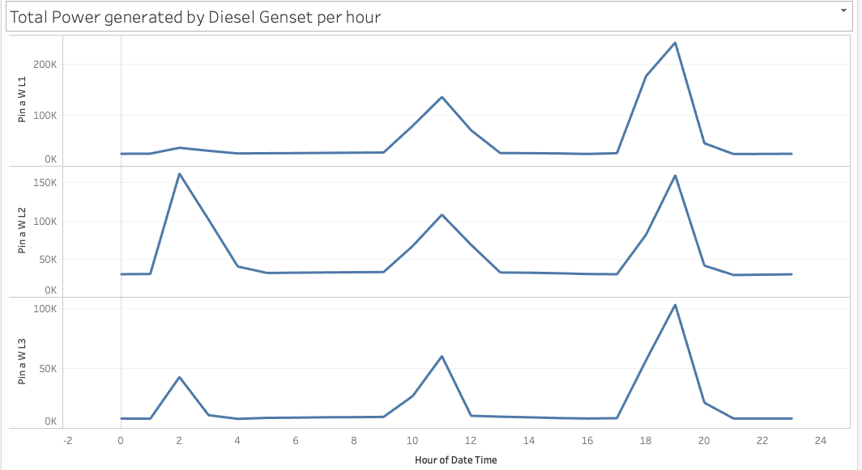
EDA: Power in (Genset) per hour (2015)

Slide 15
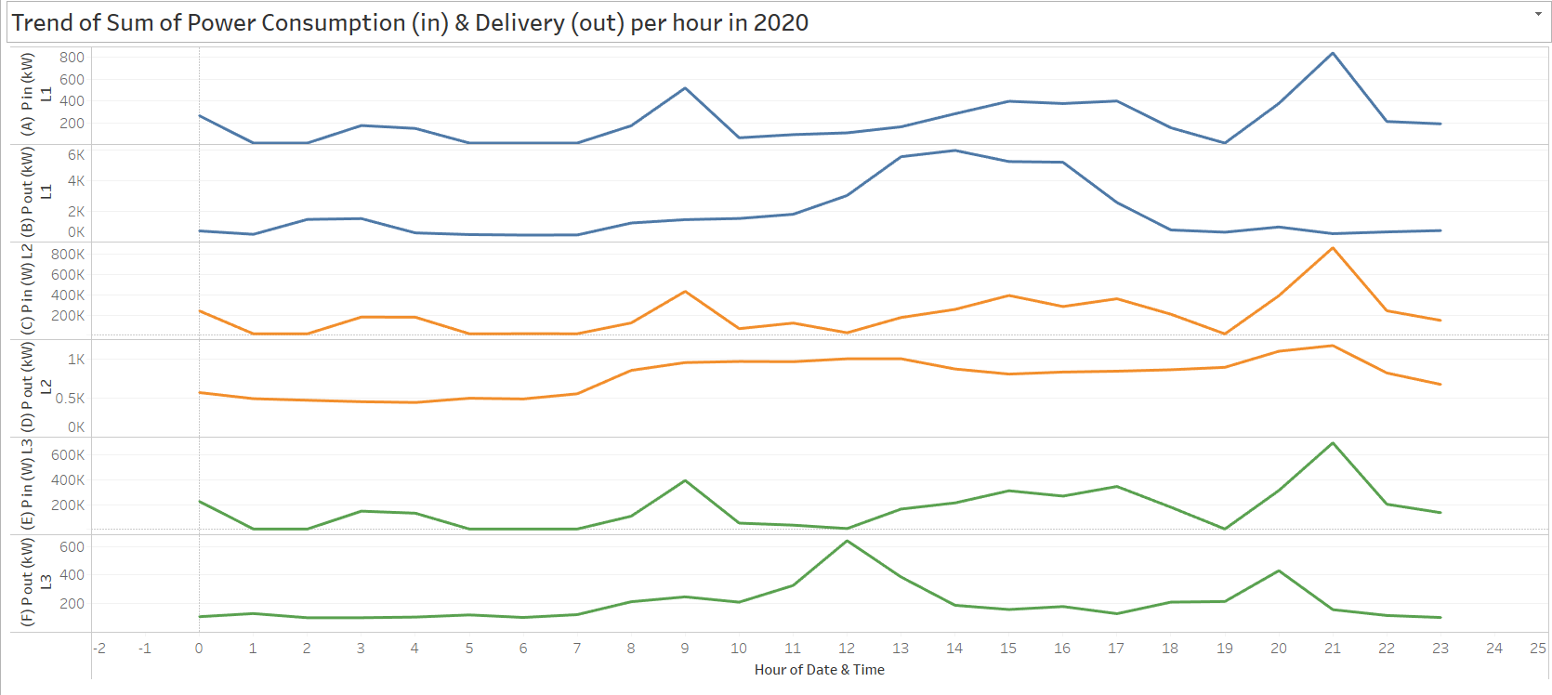
EDA: Power in & out per hour (2020)

Slide 16
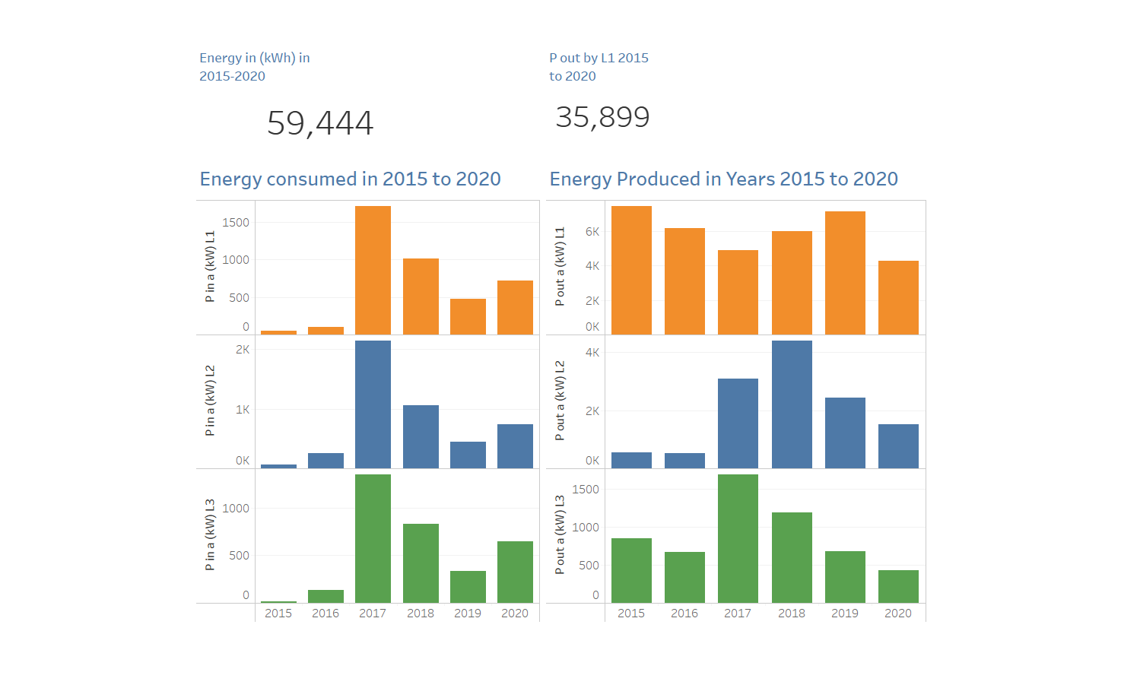
Dashboard Energy in & out 2015 to 2020

Slide 17
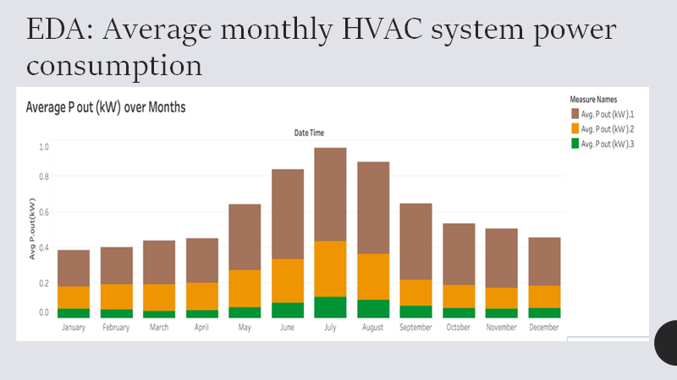

Slide 18
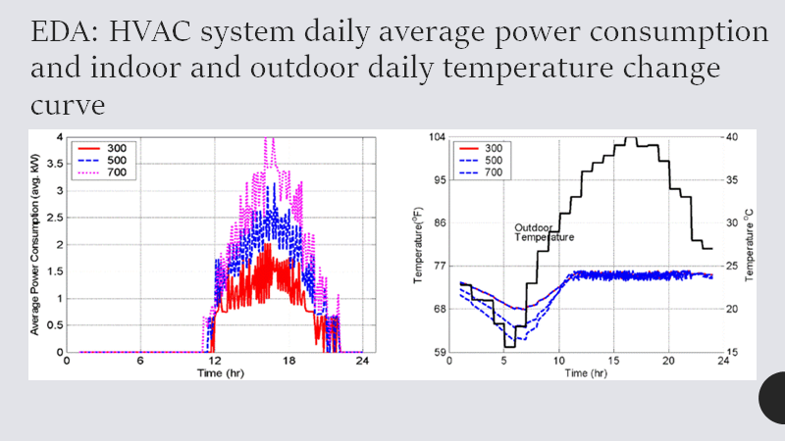

Slide 19
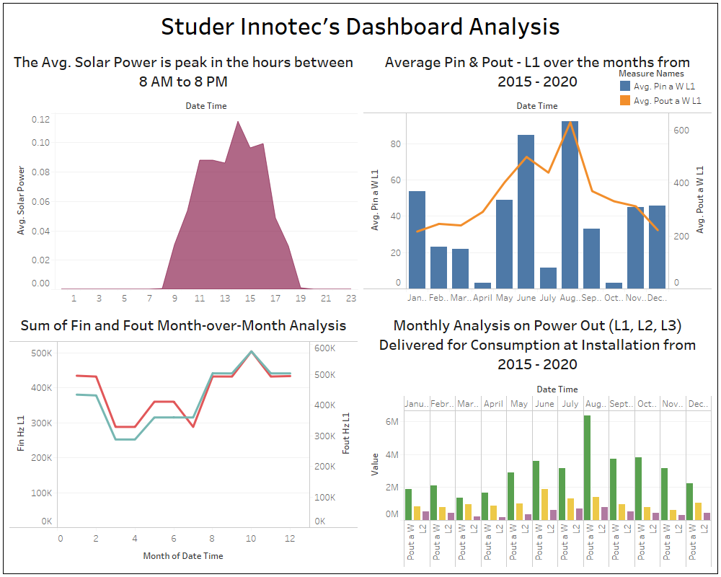

Slide 20

Failed Approaches
While merging the files by year, some had to be ignored due to parse errors
Excel does not support more than a 1 million rows
Tried to combine log files using excel script but we faced some issues
3 rows of headers had to be declared as one general header to merge data for each year in separate files
last 3 rows had some information that could not be combined

Slide 21
Findings & Recommendations
The hourly trend of the energy consumption & production shows that daytime power consumption is lower than evening time.
The recommendation here is be efficient is to optimize the power generation to produce more energy during peak hours.
The power generated by diesel genset per hour in year 2015 and 2020 are similar.
After cleaning the null value P out Max (KVA) L1 contains much more value than P out Max (KVA) L2 and P out Max (KVA) L3.
Notes:
The hourly trend of the energy consumption & production shows that hr (8 to 10) and hr (19 to 23) has the highest consumption but lowest production of the output. This is typically based on the demand of the energy specially around the industrial areas. The recommendation here is be efficient is to mobilize % of equipment producing energy around this hour and reduce the running of the machine in the low consumption hours between hr (10 to 19).

Slide 22
Conclusion
The trends show us that there are specific times when the power consumption is higher.
The goal is to explore these trends across all years (2015 – 2020).
Optimizing power generation according to the trends will help increase the efficiency of the equipment.
P out Max (KVA) L1 should be considered because the other phases are not being utilized as much.
All the data analysis and visualization tools are significant in helping to understand how Studer Innotec can optimize its goal of solar power optimization.
Among the data visualization tools, tableau comes in handy in helping to give insights on the right way of ensuring solar optimization.

